Slide 1
STV Services
Team Members
Mazin Al Ismaili
Chale Abad
Ciara Jones
Justin Balino
Francisca Okojie

Slide 2
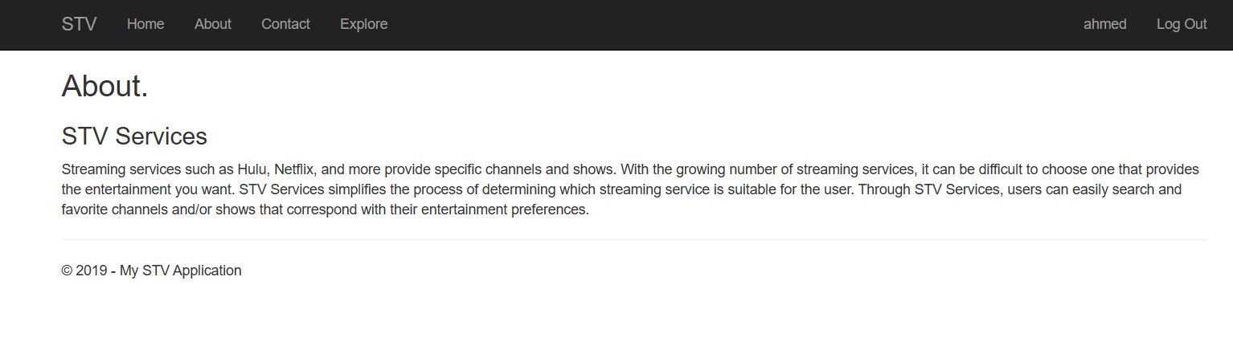
About
Notes:
Chale until Login

Slide 3
Project Tools
Visual Studio - C# and HTML, ASP.NET MVC
MySQL Database
Github
Slack

Slide 4
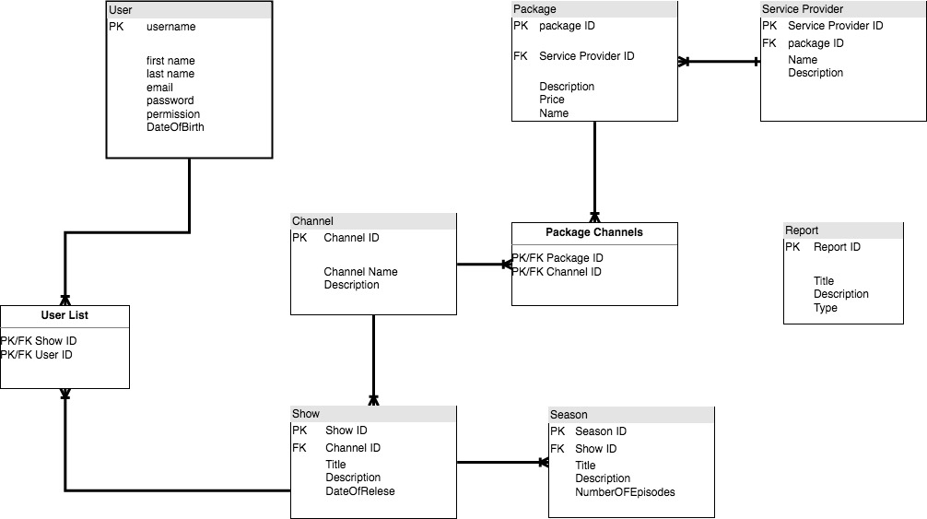
Database - MySQL
Diagram:

Slide 5
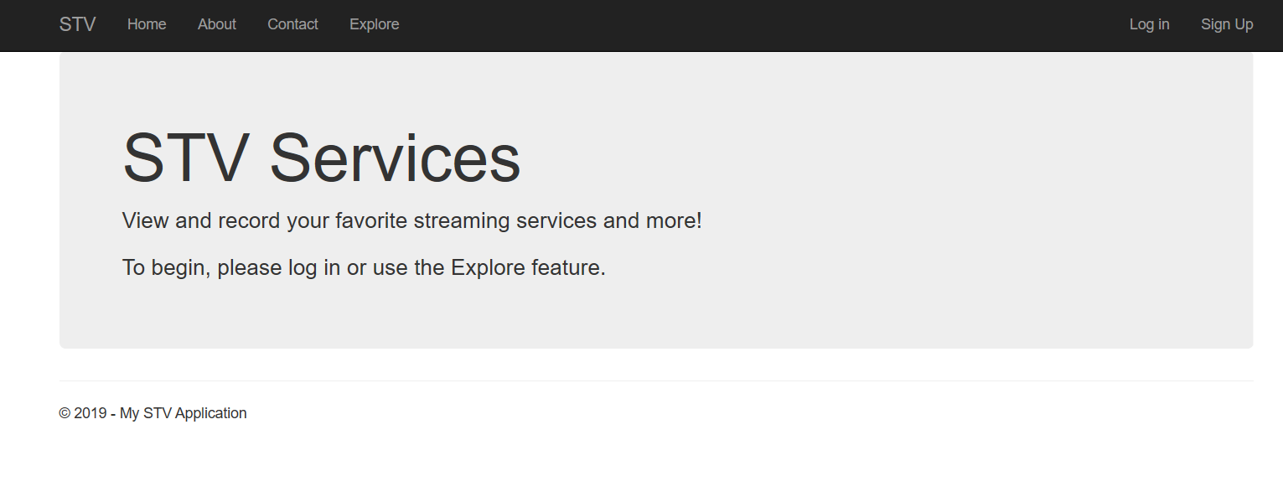
Home

Slide 6
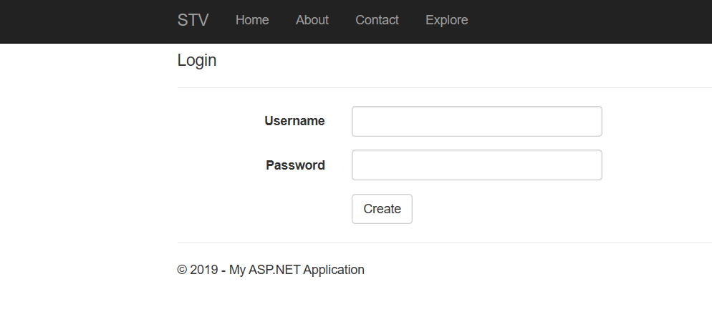
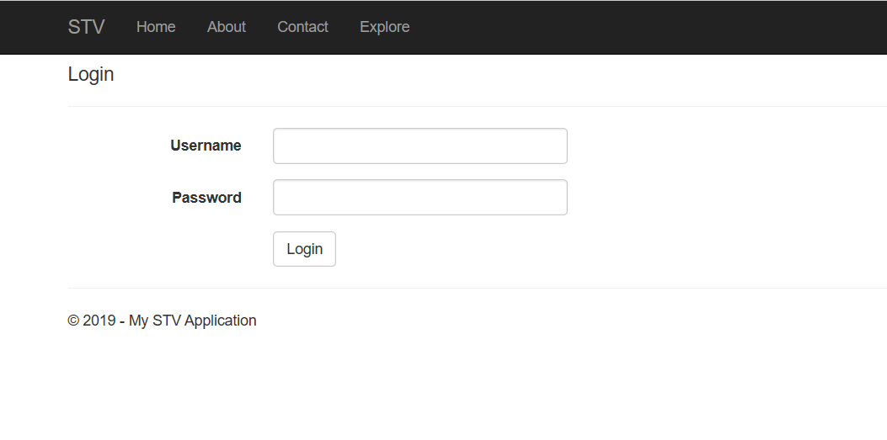
Login
Click on Login option top right.
User or Admin will enter info.
Using DataAccess model and Login function under Account - verifies and starts session.

Slide 7
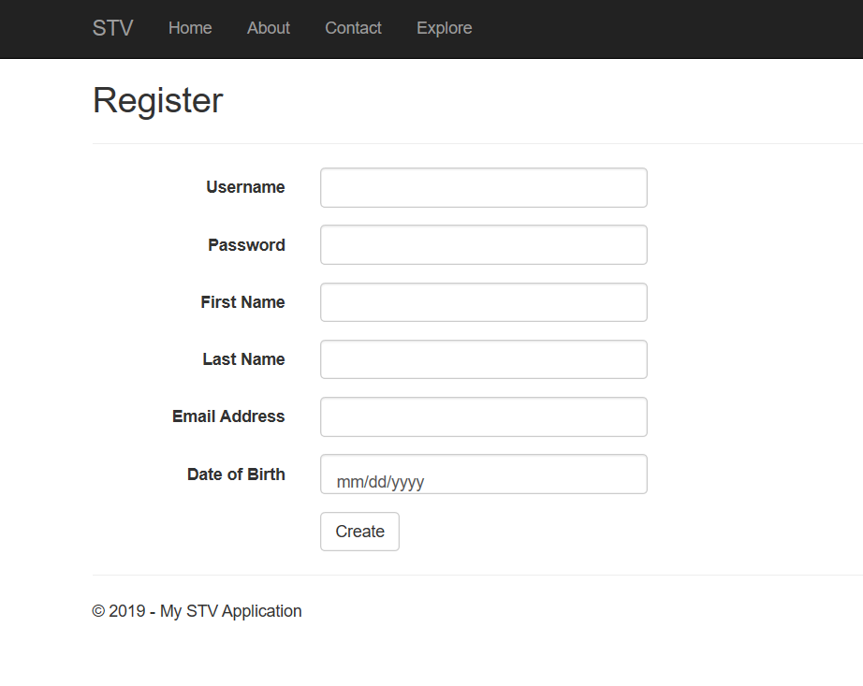
Register
When anonymous users want to have a registered account, they click Sign Up on the top right.

Slide 8
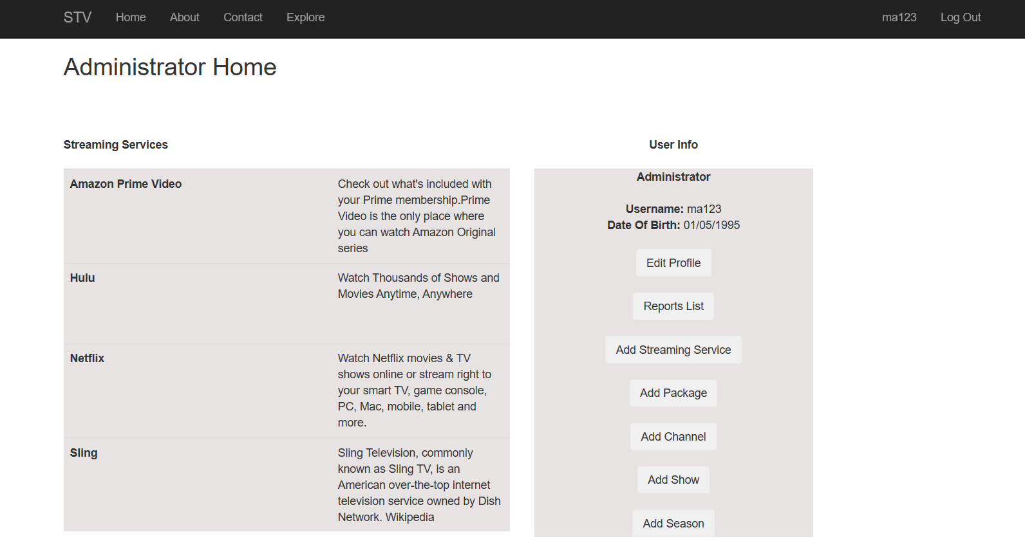
Admin Home
Streaming Services
Admin Info
Buttons
Notes:
Justin

Slide 9
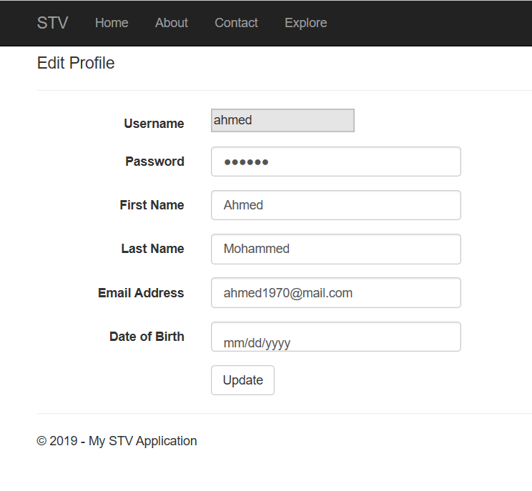
Edit Profile
Cannot change username.
Can change fields below.
Notes:
Justin

Slide 10
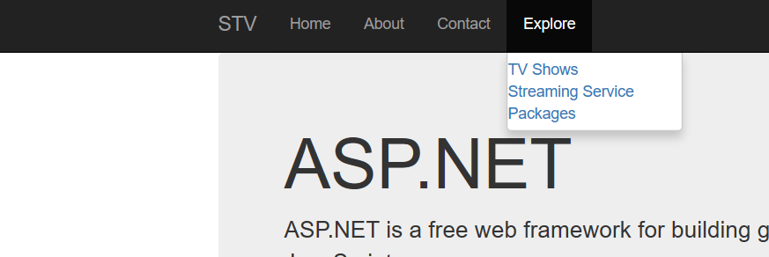
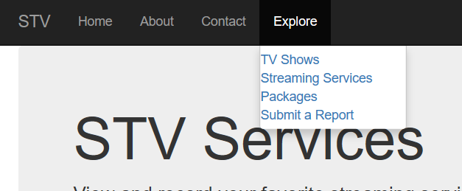
Explore Toolbar Option
Notes:
Justin

Slide 11
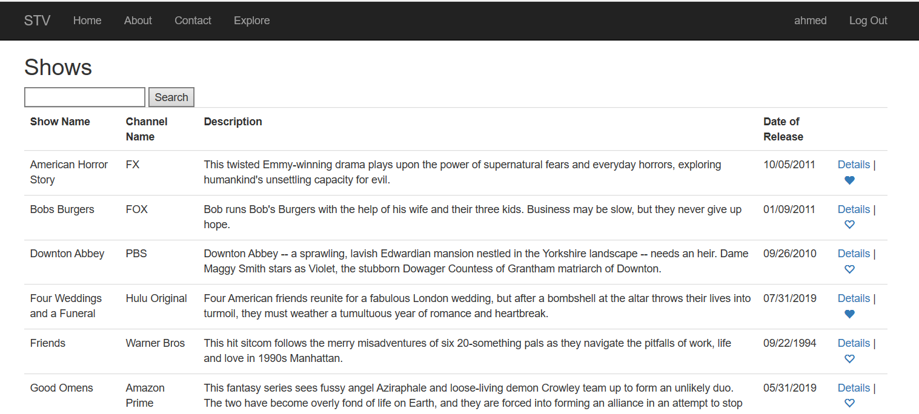
Search
Notes:
Ciara

Slide 12
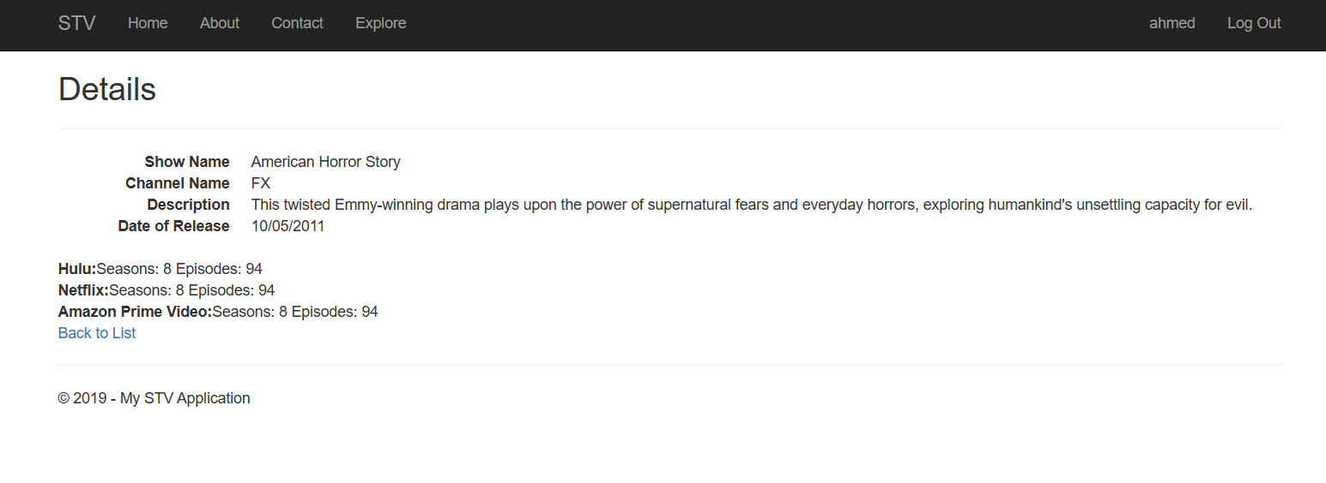
Details

Slide 13
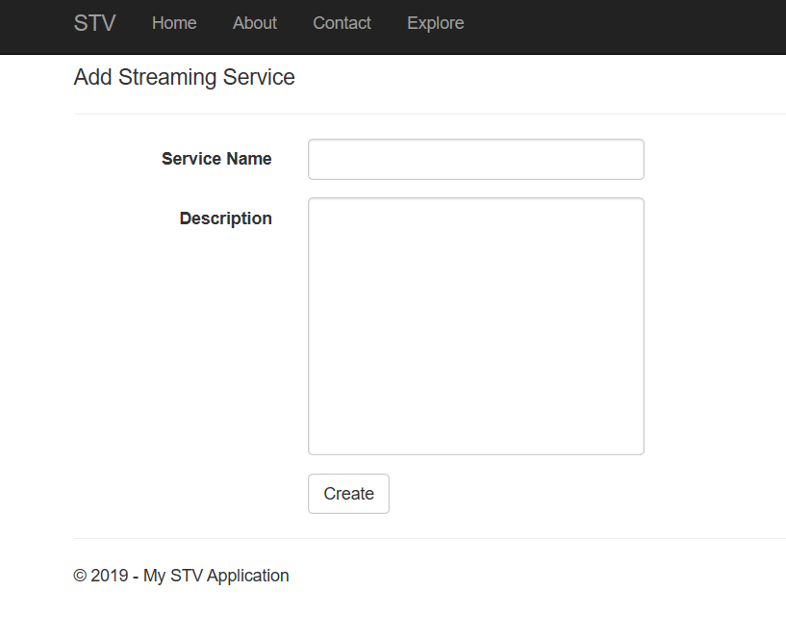
Creating Variables - Streaming Services

Slide 14
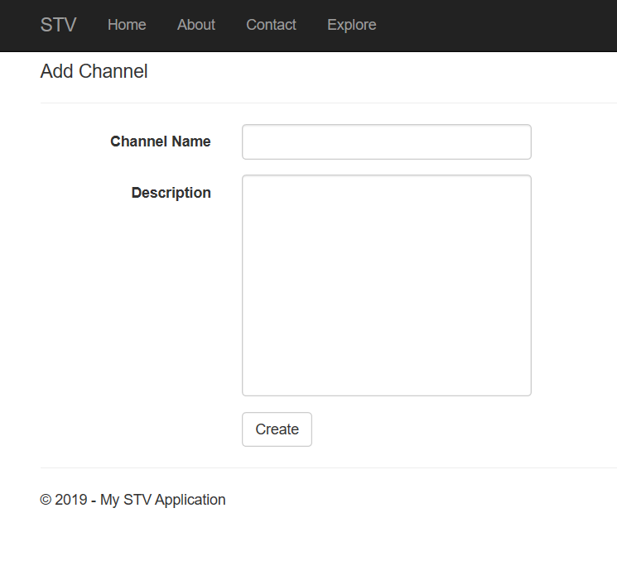
Creating Variables - Channels

Slide 15
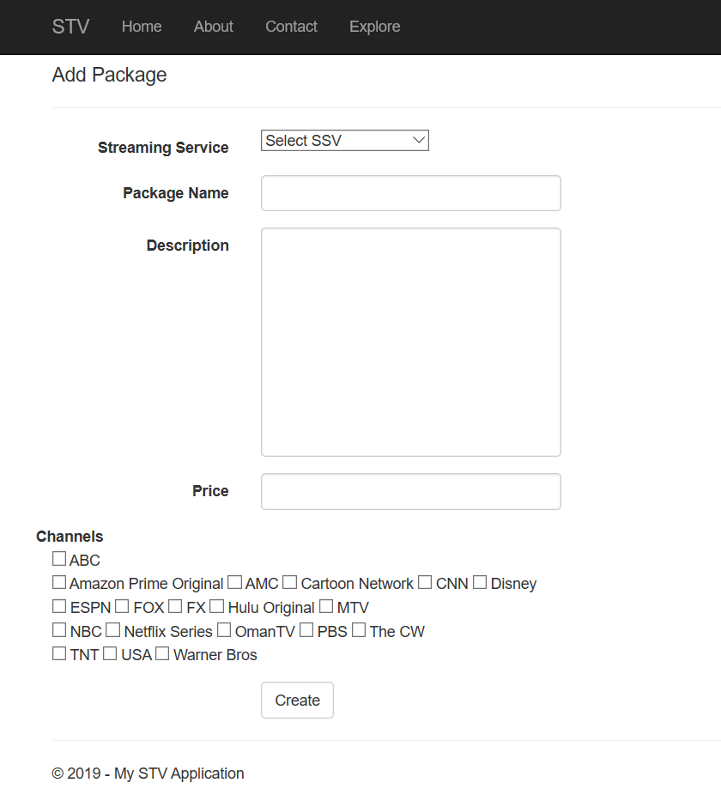
Creating Variables - Packages
Channel text boxes from database.

Slide 16
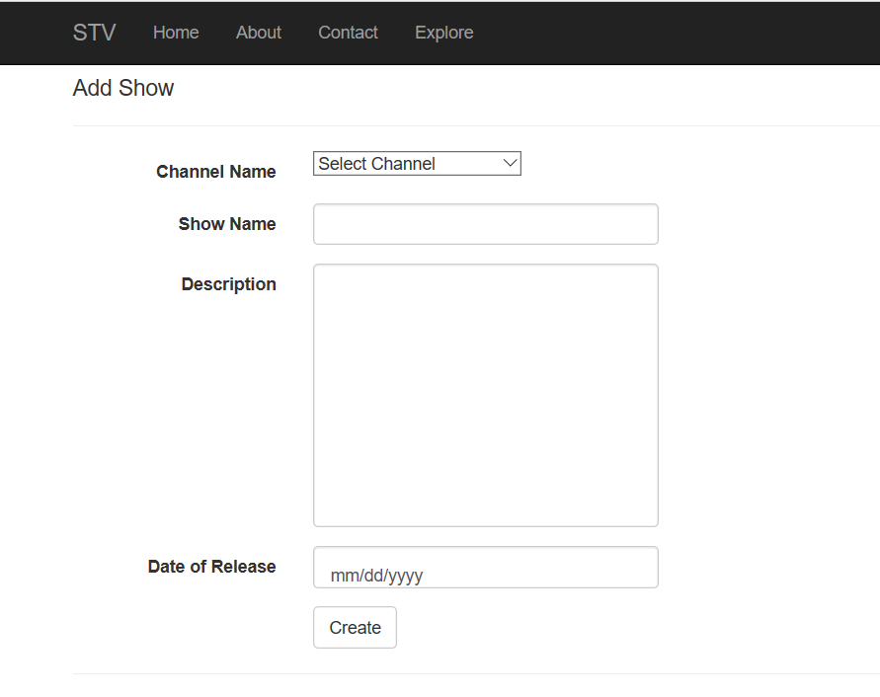
Creating Variables - Shows

Slide 17
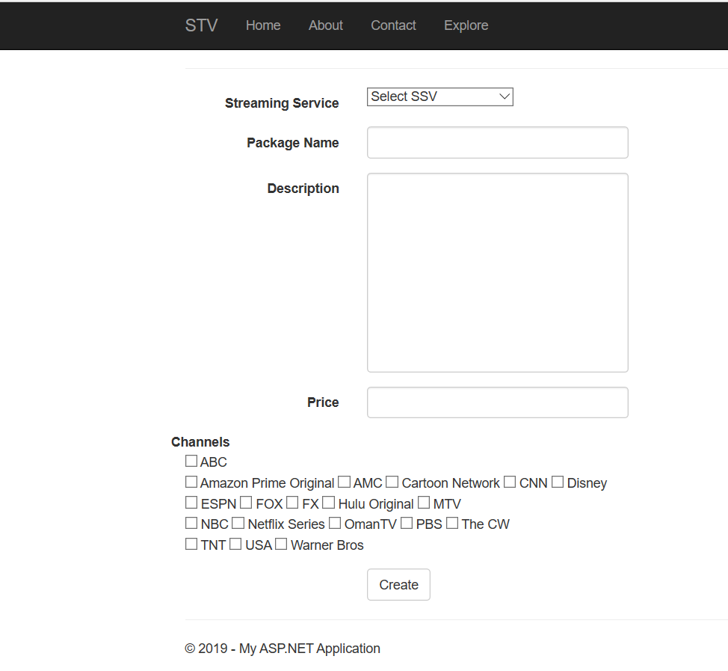
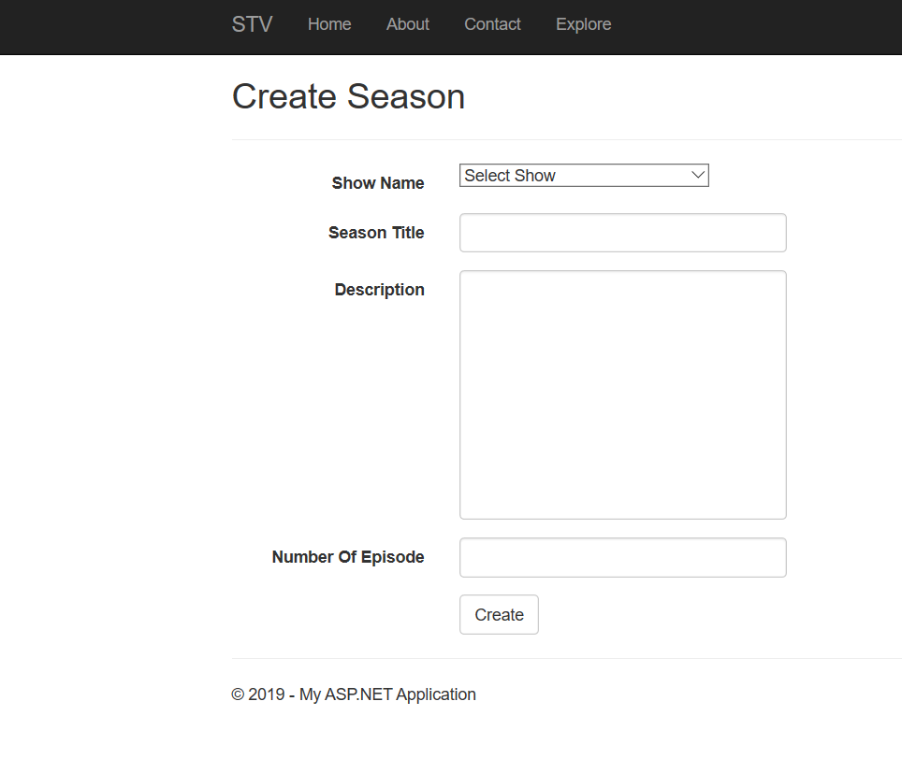
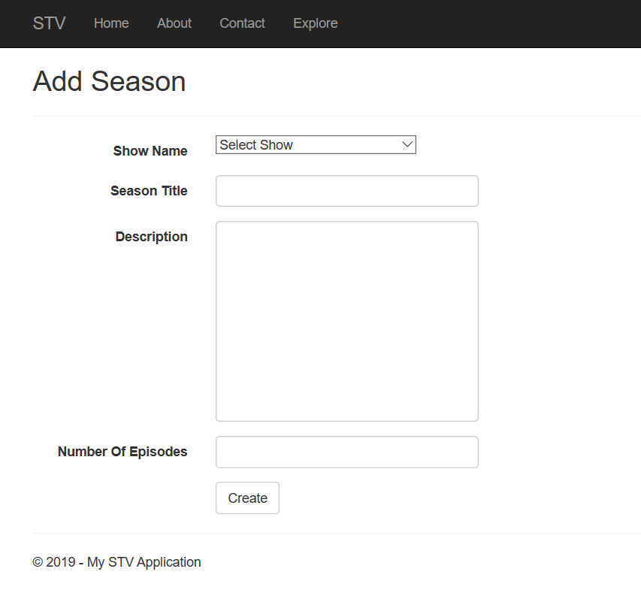
Creating Variables - Seasons
Notes:
Ciara

Slide 18
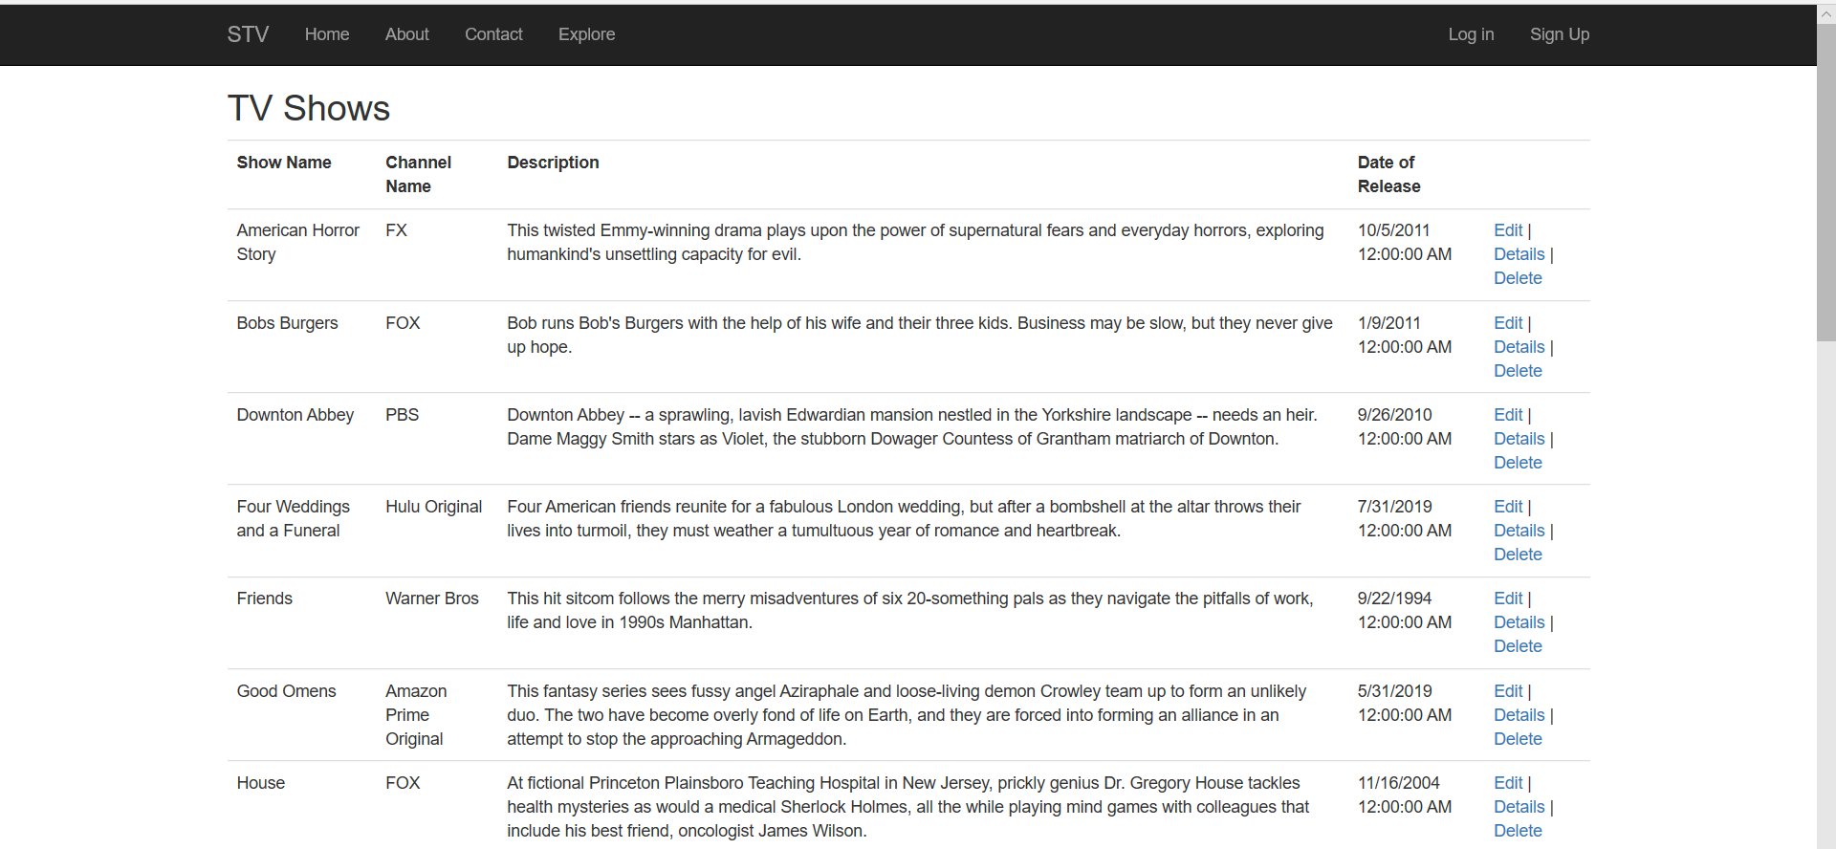
Admin View - Shows
Notes:
Francisca - new update

Slide 19
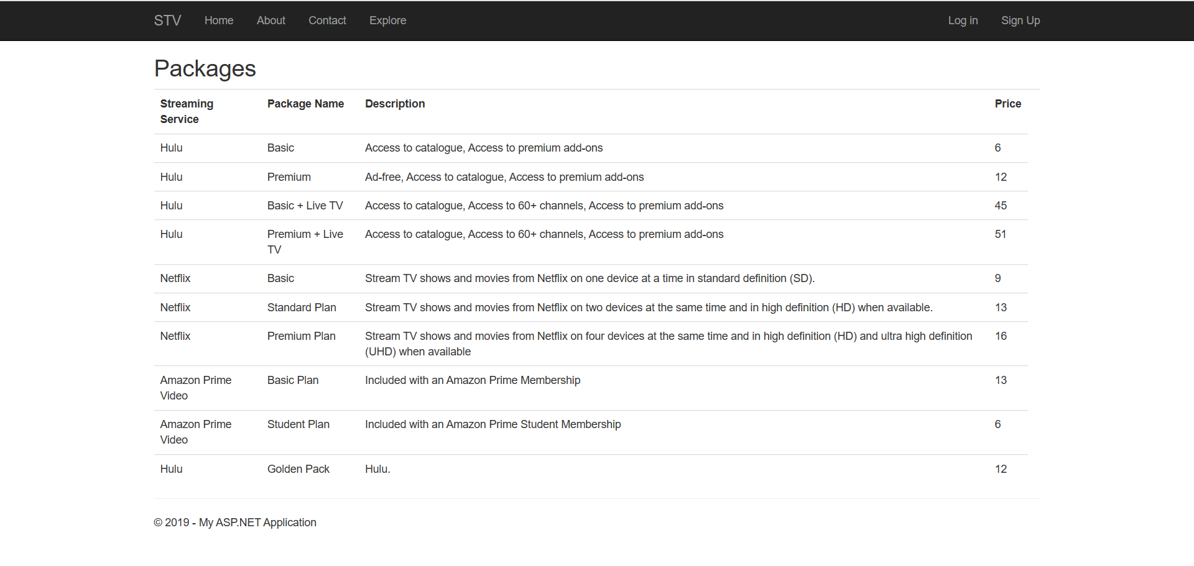
Admin View - Packages

Slide 20
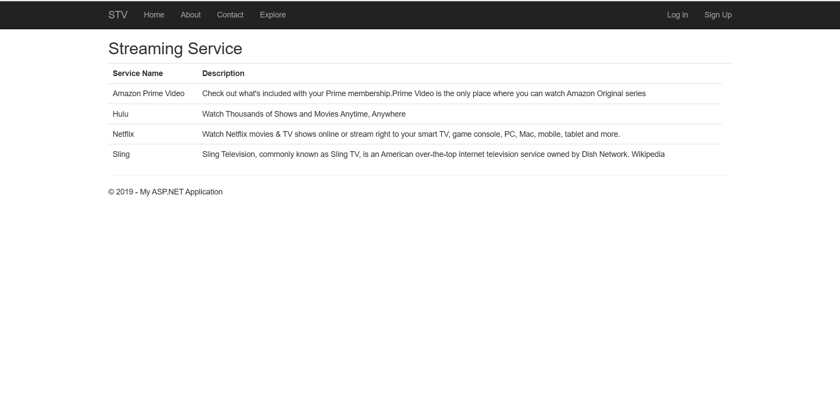
Admin View - Streaming Services

Slide 21
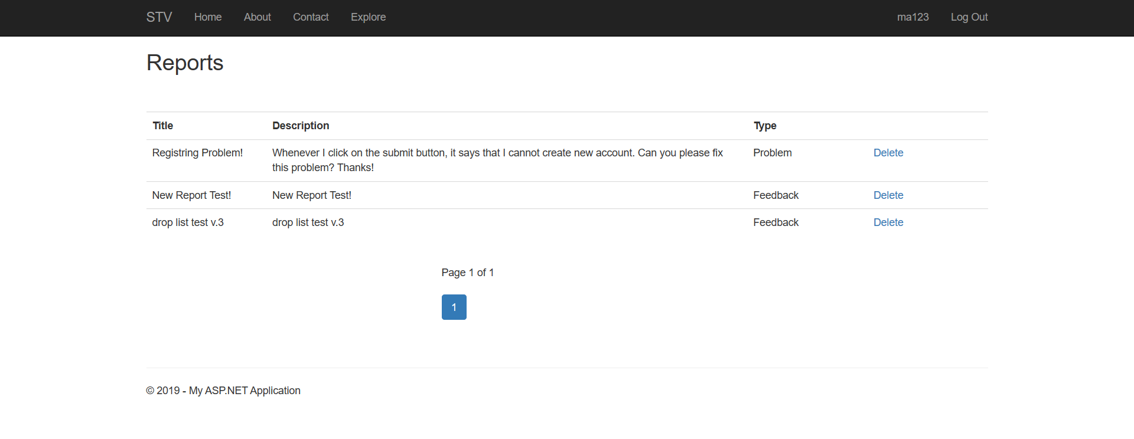
Reports View

Slide 22
Questions?

